Slide 1

Classification Project
Nathan T. , Yaniv D.
November 2023

Slide 2
Overview
Dataset and Objective
EDA
Handling Data Imbalance
Classification Models
Model Comparison
Summary
Further Analysis

Slide 3
Dataset and Objective
The train dataset contains 3722 rows, each representing a single employee, the objective is to build a model of employee future prediction
The dataset contains 9 columns:
Education
JoiningYear
City
PaymentTier
Age
Gender
EverBenched
ExperienceInCurrentDomain
Race
Objective
Predict whether the employee will leave the company or not

Slide 4
EDA and Preprocess
1. Drop duplicates (807 Rows)
2. Missing Values (2 rows)

Slide 5
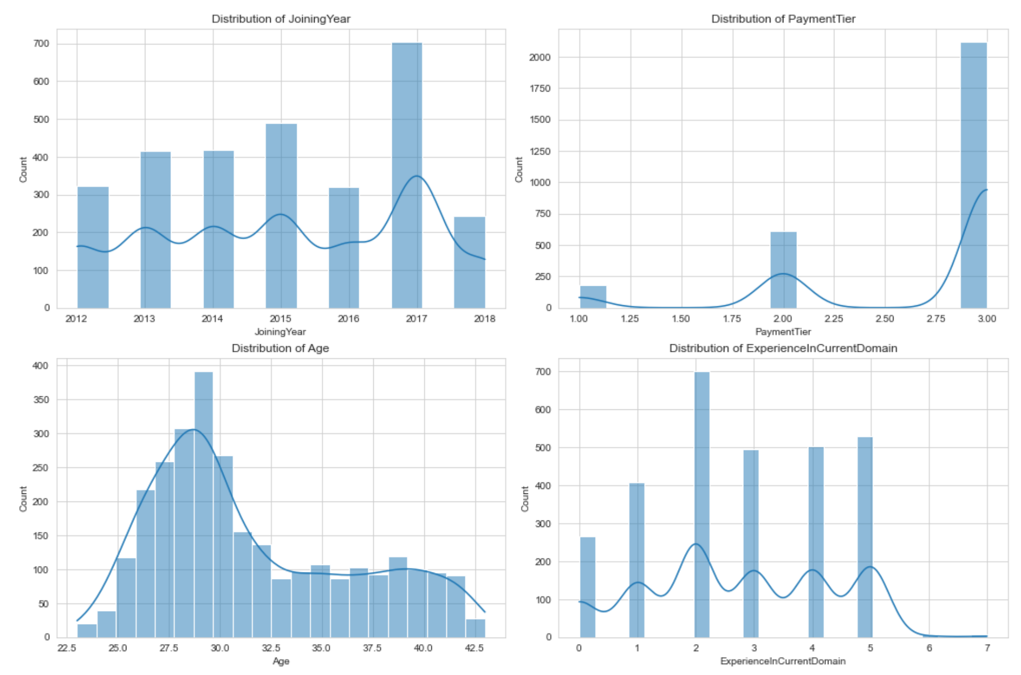
Numerical columns distribution

Slide 6
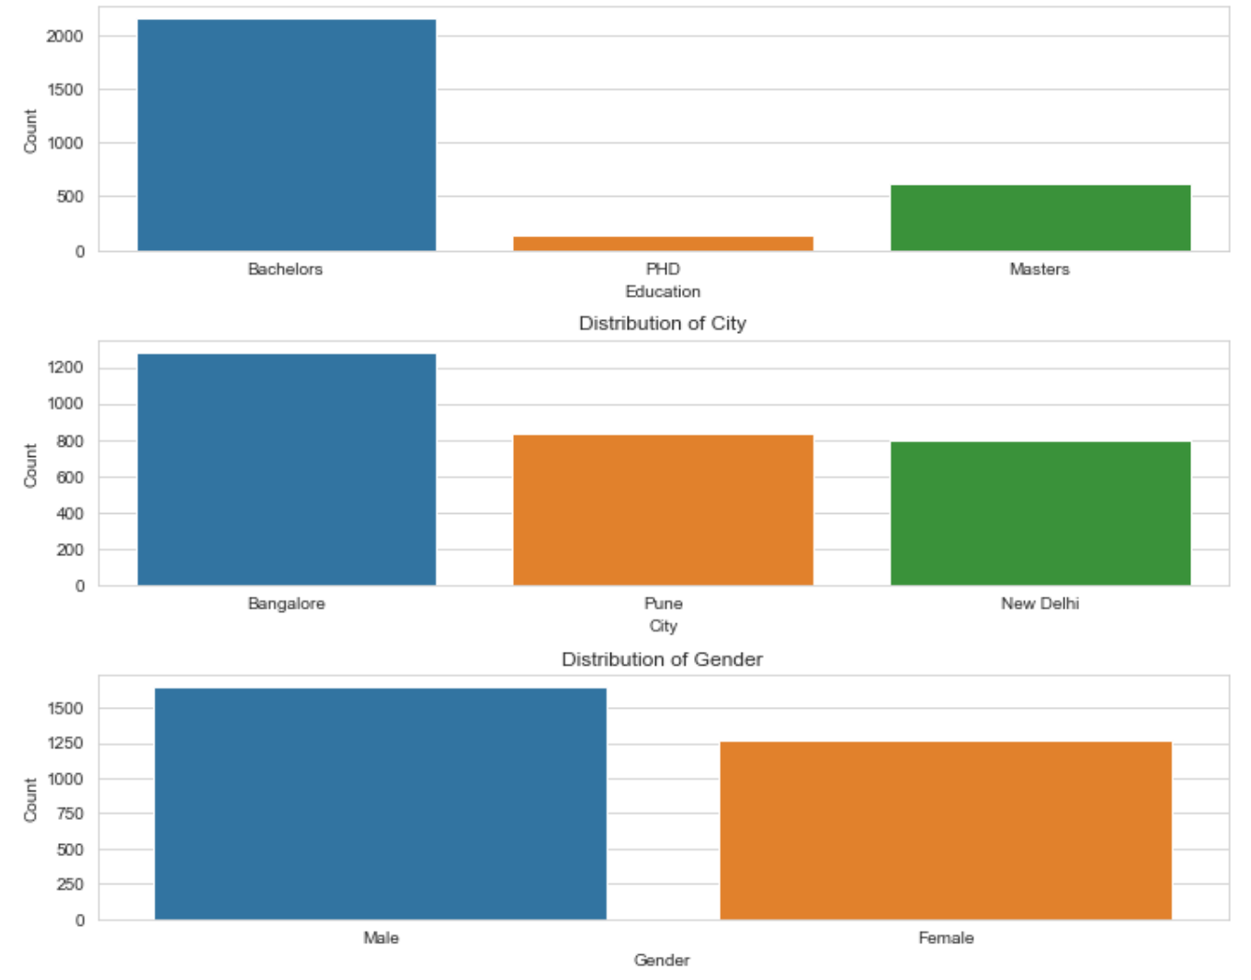
Categorial columns distribution

Slide 7
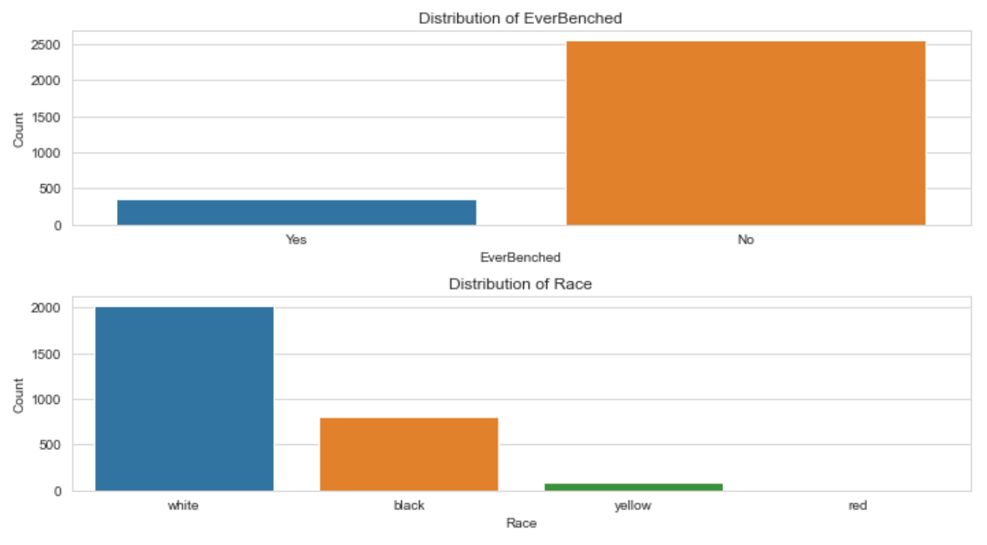
Categorial columns distribution

Slide 8
Pre-process
City, Race – Target Encoder
Education – Ordinal Encoder
JoiningYear, PaymentTier, Age, ExperienceInCurrentDomain – Simple Imputer(median)
EverBenched, Gender – Get Dummies

Slide 9
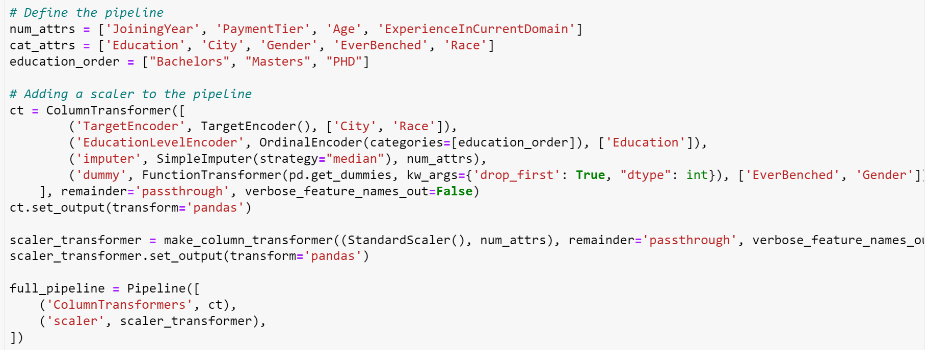
Pipeline

Slide 10
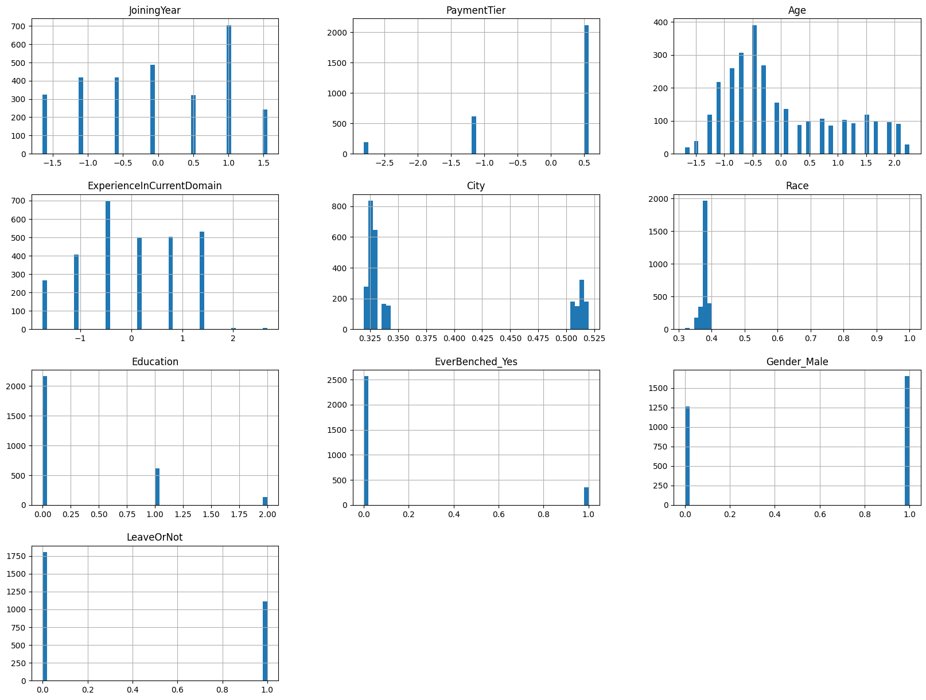
Handling Data Imbalance
Before
Applied oversampling to the minority class (train set only) Technique used: SMOTE

Slide 11
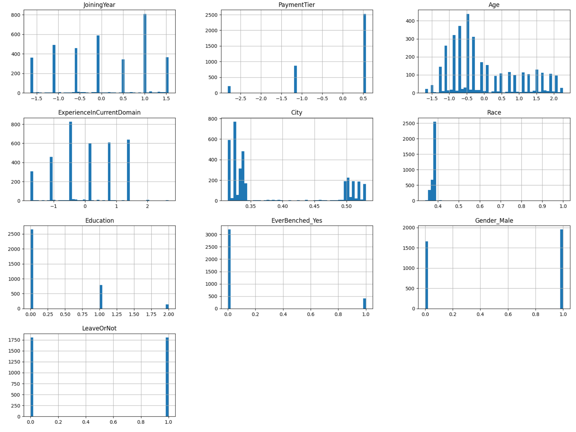
Handling Data Imbalance
After
Applied oversampling to the minority class (train set only) Technique used: SMOTE

Slide 12
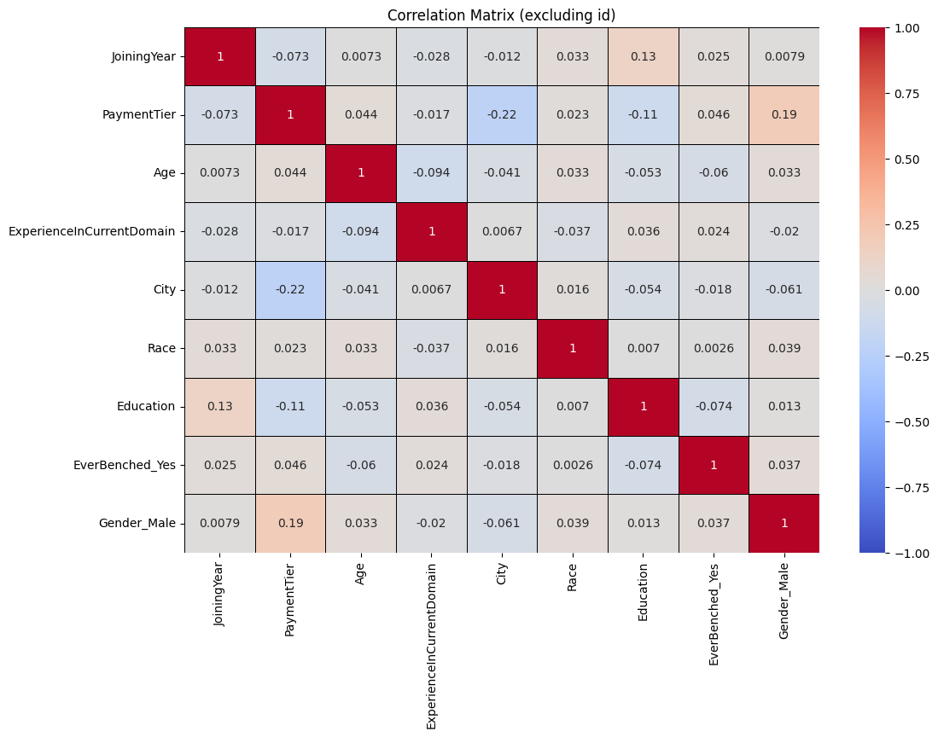
Confusion Matrix

Slide 13
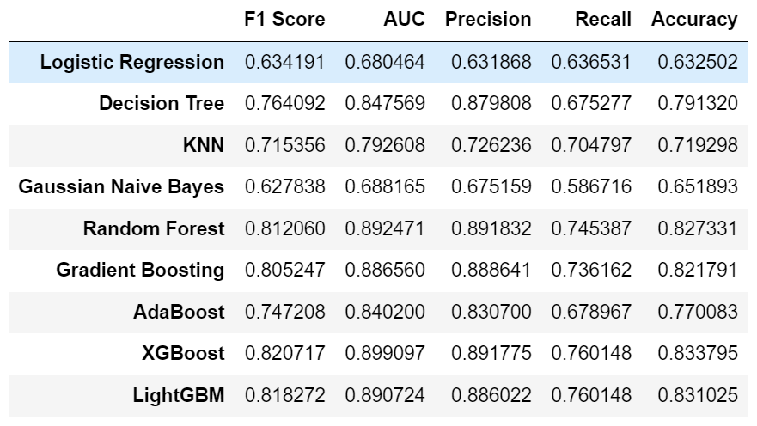
Models Comparison
Using grid search with 5-fold cv

Slide 14
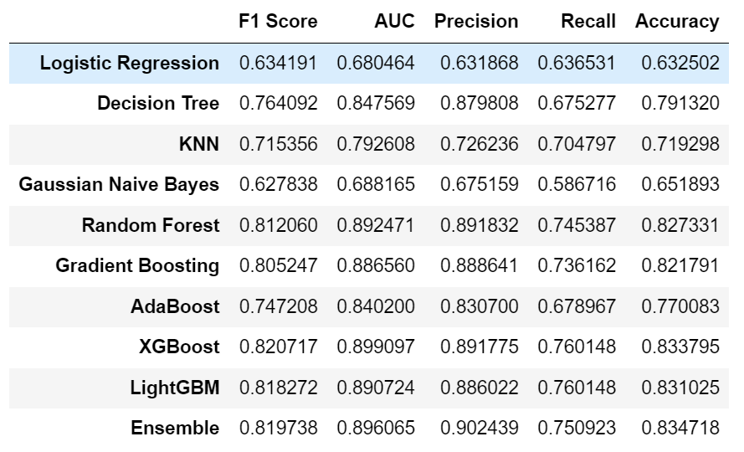
Models Ensembling Using ‘Soft’ voting
Ensembling top 5 models

Slide 15
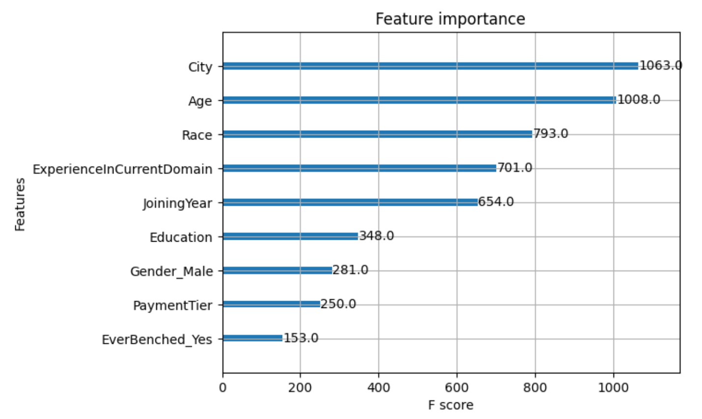
Feature Importance

Slide 16
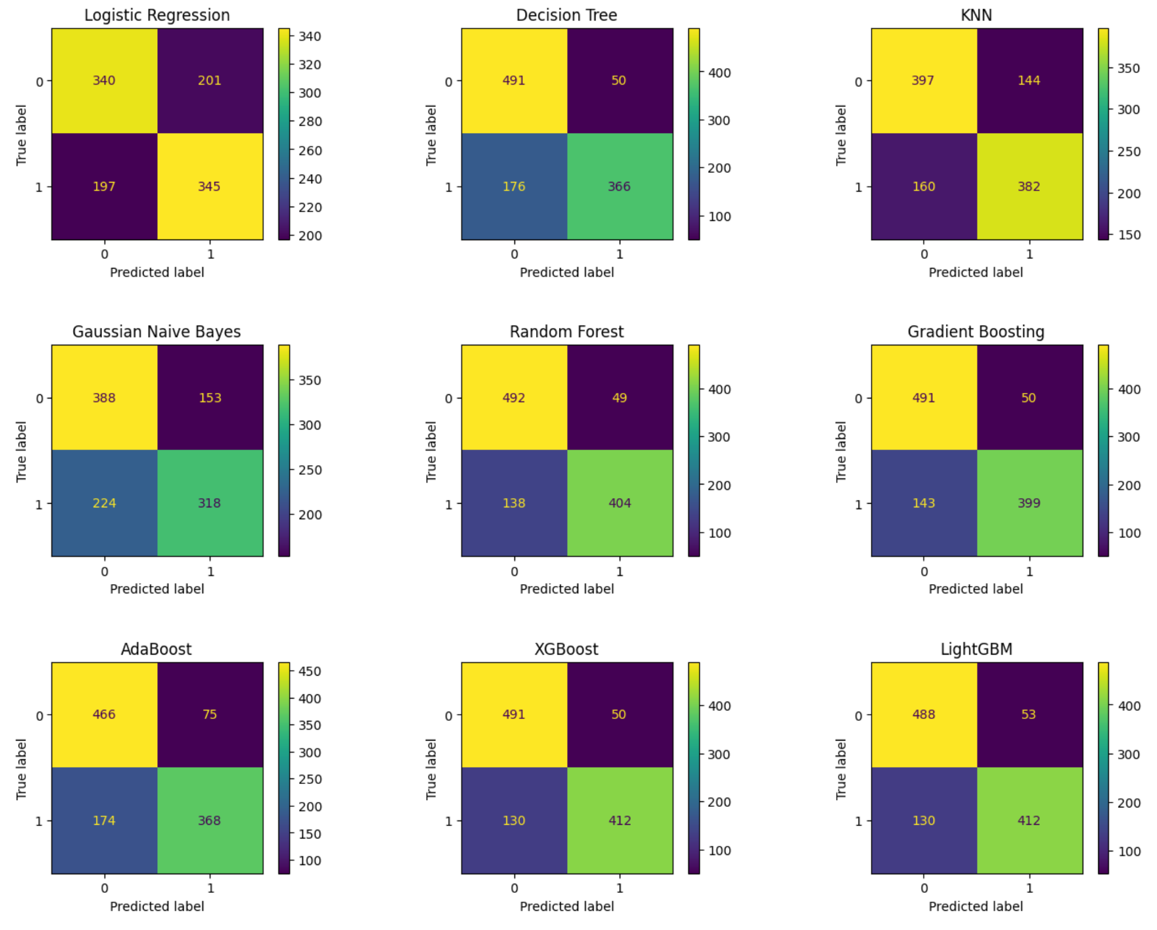
Confusion matrix for each classifier

Slide 17
Summary
The XGBoost model gives the best results on f1
The ensemble method also gives very good results and can also be chosen as the preferred model
 | F1 Score | AUC | Precision | Recall | Accuracy
XGBoost | 0.820717 | 0.899097 | 0.891775 | 0.760148 | 0.833795
Ensemble | 0.819738 | 0.896065 | 0.902439 | 0.750923 | 0.834718

Slide 18
Further Analysis
Try other methods for handling imbalanced data: Penalizing - the class_weight argument
Try other scalers (StandardScaler, etc.)
Running the models with different sets of features (based on feature selection results)
Examination with other metrics

Slide 19
Thank You

